Slide 1
Simple Linear Regression
Hillary

Slide 2
Introduction
Simple Linear regression is used to predict the value of an outcome variable Y based on one input predictor variable X. The aim is to establish a linear relationship between the predictor variable and the response variable, so that, we can use this formula to estimate the value of the response Y, when only the predictor (X) values are known. For this example we will use the ‘cars’ dataset.
head(cars) # display the first 6 observations
## speed dist ## 1 4 2 ## 2 4 10 ## 3 7 4 ## 4 7 22 ## 5 8 16 ## 6 9 10

Slide 3
Outline
Graphical Analysis
Correlation
Build Linear Model
Model Diagnostics
Machine learning

Slide 4
Graphical Analysis
Scatter plot: Visualize the linear relationship between the predictor and response.
Box plot: To spot any outlier observations in the variable. Having outliers in your predictor can drastically affect the predictions as they can easily affect the direction/slope of the line of best fit.
Density plot: To see the distribution of the predictor variable. Ideally, a close to normal distribution (a bell shaped curve), without being skewed to the left or right is preferred. Let us see how to make each one of them.

Slide 5
Scatter plot
# Visualize the relationship between response and predictor scatter.smooth(x=cars$speed,y=cars$dist,main="dist~speed")

Slide 6
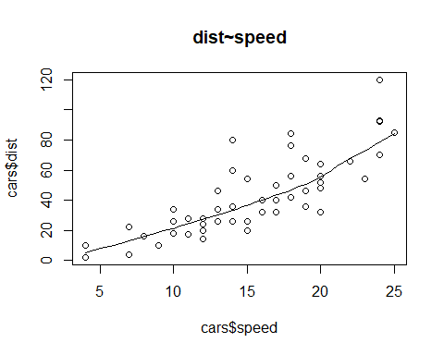

Slide 7
Box plot
# Spot any outlier that might affect the direction of the slope par(mfrow=c(1,2)) boxplot(cars$speed,main="speed",sub=paste("Outlier rows: ", boxplot.stats(cars$speed)$out)) boxplot(cars$dist,main="Distance",sub=paste("Outlier rows: ", boxplot.stats(cars$dist)$out))

Slide 8
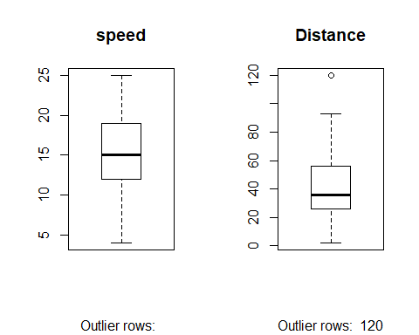

Slide 9
Density plot
library(e1071) par(mfrow=c(1,2)) plot(density(cars$speed),main="Density plot: speed",ylab="Frequency", sub=paste("Skewness: ",round(e1071::skewness(cars$speed),2))) polygon(density(cars$speed),col="red") plot(density(cars$dist),main="Density plot: dist",ylab = "Frequency", sub=paste(":Skewness: ",round(e1071::skewness(cars$dist),2))) polygon(density(cars$dist),col = "red")

Slide 10
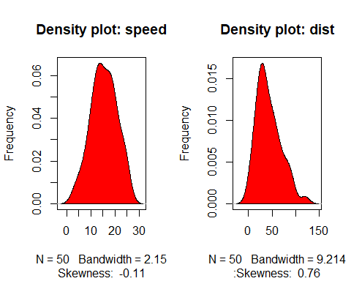

Slide 11
Correlation
This measure will show the level of linear dependence between response and predictor variable.
A value closer to 0 suggests a weak relationship between the variables, while a value closer to 1 suggests strong relationship. A low correlation (-0.2 < x < 0.2) probably suggests that much of variation of the response variable (Y) is unexplained by the predictor (X), in which case, we should probably look for better explanatory variables.
cor(cars$speed,cars$dist)
## [1] 0.8068949

Slide 12
Build Linear model
Now, we have to establish the mathematical relationship between response and predictor variable using the beta coefficient and the intercept to for the simple linear equation: dist = Intercept + (β∗speed)
LinearMod=lm(cars$dist~cars$speed) LinearMod
## ## Call: ## lm(formula = cars$dist ~ cars$speed) ## ## Coefficients: ## (Intercept) cars$speed ## -17.579 3.932

Slide 13
Model Diagnostics
Here, we have to ensure the model is statistically significant, by checking the size of the p-value, t-value, f-statistic, R-squared, Adjusted R-squared, AIC,BIC Mean Absolute Percentage Error (MAPE), Mean Squared Error (MSE)
modelSummary=summary(LinearMod) modelSummary #whole model diagnostic
## ## Call: ## lm(formula = cars$dist ~ cars$speed) ## ## Residuals: ## Min 1Q Median 3Q Max ## -29.069 -9.525 -2.272 9.215 43.201 ## ## Coefficients: ## Estimate Std. Error t value Pr(>|t|) ## (Intercept) -17.5791 6.7584 -2.601 0.0123 * ## cars$speed 3.9324 0.4155 9.464 1.49e-12 *** ## --- ## Signif. codes: 0 '***' 0.001 '**' 0.01 '*' 0.05 '.' 0.1 ' ' 1 ## ## Residual standard error: 15.38 on 48 degrees of freedom ## Multiple R-squared: 0.6511, Adjusted R-squared: 0.6438 ## F-statistic: 89.57 on 1 and 48 DF, p-value: 1.49e-12
#Break down of indiviadual elements names(modelSummary) #view the objects in the model
## [1] "call" "terms" "residuals" "coefficients" ## [5] "aliased" "sigma" "df" "r.squared" ## [9] "adj.r.squared" "fstatistic" "cov.unscaled"
modelCoeffs=modelSummary$coefficients #model coefficients modelCoeffs
## Estimate Std. Error t value Pr(>|t|) ## (Intercept) -17.579095 6.7584402 -2.601058 1.231882e-02 ## cars$speed 3.932409 0.4155128 9.463990 1.489836e-12
beta_estimate <-modelCoeffs[2,1] # get beta estimate for speed beta_estimate
## [1] 3.932409
std.error <-modelCoeffs[2,2] # Closer to zero the better std.error
## [1] 0.4155128
MSE<-(std.error)^2 #get mse for speed MSE
## [1] 0.1726509
t_value <- beta_estimate/std.error #Should be greater 1.96 for p-value to be less than 0.05 t_value
## [1] 9.46399
p_value <- 2*pt(-abs(t_value), df=nrow(cars)-ncol(cars)) # calc p Value p_value
## [1] 1.489836e-12
f_statistic <- modelSummary$fstatistic # parameters for model p-value calc f_statistic
## value numdf dendf ## 89.56711 1.00000 48.00000
R_squared<-modelSummary$r.squared #Higher the better (> 0.70) R_squared
## [1] 0.6510794
adj_R_squared<-modelSummary$adj.r.squared #Higher the better (> 0.70) adj_R_squared
## [1] 0.6438102
AIC(LinearMod) #Lower the better
## [1] 419.1569
BIC(LinearMod) #Lower the better
## [1] 424.8929

Slide 14
Machine learning
Create a training and a test data
Build the model on training data
Model evaluation: Review diagnostic measures
Model testing: Calculate prediction accuracy and error rates

Slide 15
Create a training and a test data
#Create Training and Test data set.seed(100) # setting seed to reproduce results of random sampling trainingRowIndex <- sample(1:nrow(cars), 0.8*nrow(cars))# row indices for training data trainingData <- cars[trainingRowIndex, ] # model training data dim(trainingData)
## [1] 40 2
testData <- cars[-trainingRowIndex, ]# test data dim(testData)
## [1] 10 2

Slide 16
Build the model on training data
lmMod <- lm(dist ~ speed, data=trainingData) # build the model lmMod
## ## Call: ## lm(formula = dist ~ speed, data = trainingData) ## ## Coefficients: ## (Intercept) speed ## -20.180 4.258
distPred <- predict(lmMod, testData) # predict distance head(distPred)
## 3 5 17 24 28 32 ## 9.627845 13.886057 35.177120 43.693545 47.951757 56.468182

Slide 17
Model evaluation: Review diagnostic measures
summary(lmMod)
## ## Call: ## lm(formula = dist ~ speed, data = trainingData) ## ## Residuals: ## Min 1Q Median 3Q Max ## -24.726 -11.242 -2.564 10.436 40.565 ## ## Coefficients: ## Estimate Std. Error t value Pr(>|t|) ## (Intercept) -20.1796 7.8254 -2.579 0.0139 * ## speed 4.2582 0.4947 8.608 1.85e-10 *** ## --- ## Signif. codes: 0 '***' 0.001 '**' 0.01 '*' 0.05 '.' 0.1 ' ' 1 ## ## Residual standard error: 15.49 on 38 degrees of freedom ## Multiple R-squared: 0.661, Adjusted R-squared: 0.6521 ## F-statistic: 74.11 on 1 and 38 DF, p-value: 1.848e-10

Slide 18
Model testing: Calculate prediction accuracy
Correlation accuracy
actuals_preds <- data.frame(cbind(actuals=testData$dist, predicteds=distPred)) # make actuals_predicteds dataframe. correlation_accuracy <- cor(actuals_preds) head(actuals_preds)
## actuals predicteds ## 3 4 9.627845 ## 5 16 13.886057 ## 17 34 35.177120 ## 24 20 43.693545 ## 28 40 47.951757 ## 32 42 56.468182
Min-max accuracy and Mean absolute percentage error
min_max_accuracy <- mean(apply(actuals_preds, 1, min)/apply(actuals_preds, 1, max)) min_max_accuracy
## [1] 0.7311131
mape <- mean(abs((actuals_preds$predicteds-actuals_preds$actuals))/actuals_preds$actuals) mape
## [1] 0.4959096

